Slide 1
Data Structures
& Algorithms
IIT’H

Slide 2
Motivation
Learning Data Structures and Algorithms is essential because it helps solve problems efficiently and optimizes code performance.
It is crucial for real-world applications like search engines and scalable systems, and it's a key part of technical interviews at top tech companies. Understanding DSA equips you with the tools to think logically and solve complex problems effectively.

Slide 3
Global Market Size and Its Forecast
The demand for professionals skilled in Data Structures and Algorithms (DSA) is rapidly increasing as industries seek efficient problem-solvers to handle complex data challenges. DSA is crucial for optimizing applications, making it a high-demand skill in tech-driven economies.
Here are some key stats: The global software development market, driven by DSA skills, is projected to grow significantly, with a CAGR of 26% by 2028. Tech giants like Google, Amazon, and Facebook heavily emphasize DSA knowledge in their hiring processes.
Proficiency in DSA can significantly boost earning potential. The average salary for software engineers with strong DSA skills can range from $120,000 to $150,000 per year in the U.S., depending on experience and location. Mastering DSA opens doors to top-tier tech jobs and competitive salaries across industries.
Source: Forbes
Notes:
Thinking Humanly: Cognitive Modeling
Cognitive Modeling: This approach is about understanding how humans think and then trying to create a program that thinks the same way.
How do we do this? Scientists study human thought through things like introspection (thinking about how we think), experiments, and brain imaging.
Example: A computer program designed to solve puzzles in the same steps and manner a human would.

Slide 4
How Data Structures and Algorithms Are Used in Daily Life
Navigation Apps (Google Maps, Waze):
Algorithm: Shortest path algorithms like Dijkstra’s or A* help find the fastest route.
Data Structures: Graphs represent roads and intersections, where each node is a location, and edges are paths.
Social Media (Facebook, Instagram):
Algorithm: Feed algorithms prioritize posts based on relevance, using ranking algorithms.
Data Structures: Graphs represent social connections (friends, followers), arrays or hash maps store user data and posts.
E-commerce (Amazon, Flipkart):
Algorithm: Recommendation algorithms suggest products based on user behavior using collaborative filtering.
Data Structures: Arrays and hash maps store product data, queues manage order processing, trees handle category sorting.
Banking Systems:
Algorithm: Encryption algorithms secure transactions, while sorting and searching algorithms manage customer data.
Data Structures: Hash maps store account details, linked lists handle transaction history, queues manage requests.
Notes:
Thinking Humanly: Cognitive Modeling
Cognitive Modeling: This approach is about understanding how humans think and then trying to create a program that thinks the same way.
How do we do this? Scientists study human thought through things like introspection (thinking about how we think), experiments, and brain imaging.
Example: A computer program designed to solve puzzles in the same steps and manner a human would.

Slide 5
Table of contents
01
02
03
04
05
Introduction to DSA
C++ Essentials
Data Types
Pointers
Arrays

Slide 6
01
Introduction to
Data Structures
(AI)

Slide 7
What is a Data Structure?
(According to WikiPedia)
A Data structure is representation of the logical relationship existing between individual elements of data.
A data structure is a collection of data values, the relationships among them, and the functions or operations that can be applied to the data.

Slide 8


Slide 9
What is a Data Structure?
Data is information stored in computers.
A data structure is a way of storing data in a computer so that it can be accessed and used efficiently.
Data structures are important because the information can be organized, processed, stored, and retrieved quickly and effectively.
They are a means of handling information, rendering the data for easy use.
Notes:
Human-like vs. Rational: Some definitions compare AI's success by how closely it imitates human thinking or behavior, while others measure it by how logically or "rationally" it performs tasks, regardless of whether it's like a human or not.

Slide 10
Algorithm:
An algorithm is a process or a set of rules required to perform calculations or some other problem-solving operations especially by a computer. The formal definition of an algorithm is that it contains the finite set of instructions which are being carried in a specific order to perform the specific task.
Every application, piece of software, or programs foundation consists of two components: algorithms and data. Data is information, and algorithms are rules and instructions that turn the data into something useful to programming.
Notes:
Thinking Humanly: Cognitive Modeling
Cognitive Modeling: This approach is about understanding how humans think and then trying to create a program that thinks the same way.
How do we do this? Scientists study human thought through things like introspection (thinking about how we think), experiments, and brain imaging.
Example: A computer program designed to solve puzzles in the same steps and manner a human would.

Slide 11
Characteristics of an Algorithm:
The following are the characteristics of an algorithm:
Input: An algorithm has some input values. We can pass 0 or some input value to an algorithm.
Output: We will get 1 or more output at the end of an algorithm.
Unambiguity: An algorithm should be unambiguous which means that the instructions in an algorithm should be clear and simple.
Finiteness: An algorithm should have finiteness. Here, finiteness means that the algorithm should contain a limited number of instructions, i.e., the instructions should be countable.
Effectiveness: An algorithm should be effective as each instruction in an algorithm affects the overall process.
Language independent: An algorithm must be language-independent so that the instructions in an algorithm can be implemented in any of the languages with the same output.
Notes:
Thinking Humanly: Cognitive Modeling
Cognitive Modeling: This approach is about understanding how humans think and then trying to create a program that thinks the same way.
How do we do this? Scientists study human thought through things like introspection (thinking about how we think), experiments, and brain imaging.
Example: A computer program designed to solve puzzles in the same steps and manner a human would.

Slide 12
Why are Data Structures and Algorithms Important?
Data Structures and Algorithms are an essential part of Computer Science and programming. They are used to solve real-world problems by processing and manipulating large amounts of data. If we use the Data Structures and Algorithms efficiently, then we can increase the execution speed of the program and reduce the time.
Efficient Problem Solving: DSA helps design solutions that work efficiently in terms of time and space.
Optimized Performance: They ensure faster execution of programs, especially for large datasets, improving user experience.
Foundation for Advanced Topics: DSA knowledge is fundamental for areas like AI, machine learning, and system design.
Scalability: Good DSA ensures systems can scale effectively, handling more data or users without compromising performance.
Notes:
Thinking Humanly: Cognitive Modeling
Cognitive Modeling: This approach is about understanding how humans think and then trying to create a program that thinks the same way.
How do we do this? Scientists study human thought through things like introspection (thinking about how we think), experiments, and brain imaging.
Example: A computer program designed to solve puzzles in the same steps and manner a human would.

Slide 13
Introduction to C++
General-purpose programming language: C++ is versatile, used for system software, games, mobile apps, etc.
Developed by Bjarne Stroustrup in 1985: It extended the C language to include object-oriented features.
Extension of C: Adds classes, objects, and other advanced features, making it more powerful.
Performance-critical applications: Used where speed is key, like game engines and high-performance simulations.
Example: C++ is used to develop parts of popular video games like "The Witcher" and "PUBG."

Slide 14
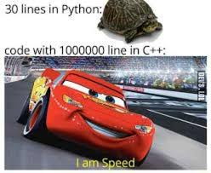

Slide 15
Features of C++
Object-Oriented Programming (OOP): Supports classes, inheritance, polymorphism, encapsulation. Example: Imagine a class called "Car" with attributes like "speed" and methods like "accelerate." You can create multiple car objects with different speeds.
Low-Level Manipulation: Access hardware-level features using pointers. Example: Using pointers to directly access memory in game development for faster performance.
Standard Template Library (STL): Offers built-in data structures like vectors and algorithms like sorting. Example: Instead of manually coding a sorting algorithm, you can use std::sort() from the STL.
Multi-Paradigm: Supports procedural, object-oriented, and generic programming (templates).
Platform-Independent: Code written in C++ can be compiled and run on various platforms.

Slide 16
Basic Structure of a C++ program
#include: Includes standard libraries, e.g., <iostream> for input/output functions.
int main(): Every C++ program starts with the main() function where execution begins.
return 0;: Returns a value to indicate successful completion.
Example:
#include <iostream>
using namespace std;
int main() {
cout << "Hello, World!";
return 0;
}

Slide 17
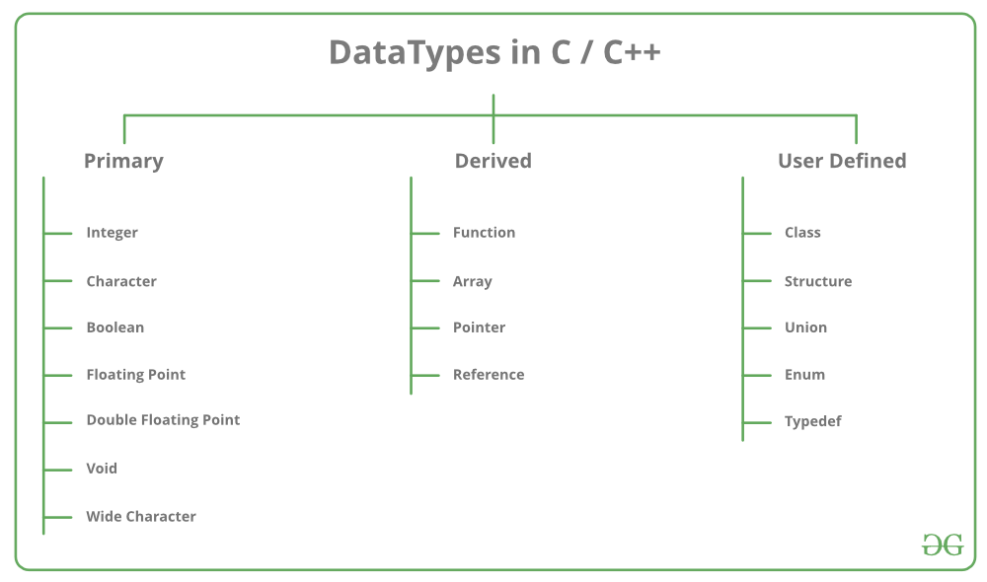
Data Types in C++

Slide 18
Conditional Statements
The conditional statements (also known as decision control structures) such as if, if else, switch, etc. are used for decision-making purposes in C programs.
if statement: Executes a block of code if the condition is true.
else if statement: Adds more conditions.
else statement: Executes if all conditions are false.
Example:
if (age > 18) { std::cout << "Adult"; } else { std::cout << "Minor"; }

Slide 19
Loops
for loop: Used when the number of iterations is known.
for (int i = 1; i <= 5; i++) { std::cout << i; }
while loop: Runs while a condition is true.
while (count < 10) {
std::cout << count;
count++;
}
do-while loop: Executes at least once before checking the condition.
Loop Control: Use break to exit a loop early or continue to skip to the next iteration.

Slide 20
Functions
#include <iostream>
using namespace std;
int max(int x, int y)
{
if (x > y)
return x;
else
return y;
}
int main()
{
int a = 10, b = 20;
int m = max(a, b);
cout << "m is " << m;
return 0;
}
A function is a set of statements that takes input, does some specific computation, and produces output. The idea is to put some commonly or repeatedly done tasks together to make a function so that instead of writing the same code again and again for different inputs, we can call this function.
In simple terms, a function is a block of code that runs only when it is called.

Slide 21
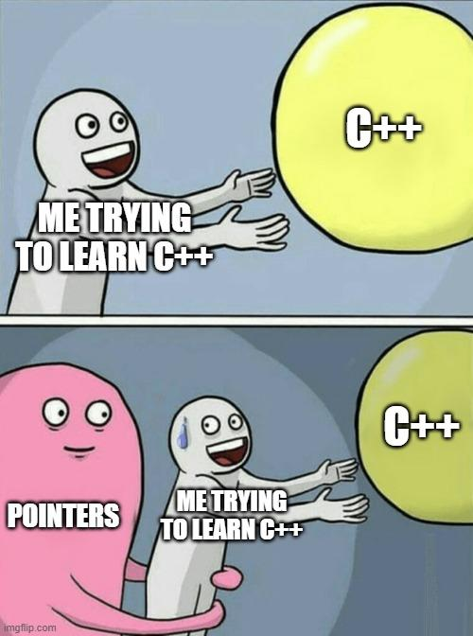
Pointers in C++
In C++ pointers and references both are mechanisms used to deal with memory, memory address, and data in a program.
Pointers are used to store the memory address of another variable whereas references are used to create an alias for an already existing variable.
Example:
int num = 10;
int* ptr = &num;
std::cout << *ptr; // prints 10
Notes:
Acting Humanly: The Turing Test
Turing Test: Imagine you're chatting with someone online, and you can't tell if it's a person or a computer. If the computer can fool you into thinking it's human, it passes the Turing Test.
What's needed for this? The computer needs to understand and use language (natural language processing), remember information (knowledge representation), make decisions (automated reasoning), and learn from new experiences (machine learning).
Example: Siri or Alexa trying to answer your questions in a way that feels like you're talking to a person.

Slide 22
Why Use C++ for DSA?
Performance: C++ offers faster execution due to its proximity to hardware, making it an ideal choice for implementing complex data structures and algorithms where efficiency is key.
Memory Management: With features like pointers and dynamic memory allocation (new and delete), C++ provides fine-grained control over memory, which is crucial for optimizing data structure implementations.
Standard Template Library (STL): C++ comes with a powerful Standard Template Library (STL) that includes pre-built data structures (like vectors, stacks, queues, maps) and algorithms (like sorting, searching), saving time and effort when implementing common solutions.
Object-Oriented Programming (OOP): C++ combines the power of procedural and object-oriented programming, allowing you to model data structures effectively and design algorithms in a structured, maintainable way.
Widely Used in Competitive Programming: C++ is the preferred language in competitive programming due to its speed and STL, making it easier to solve problems involving data structures and algorithms quickly.

Slide 23
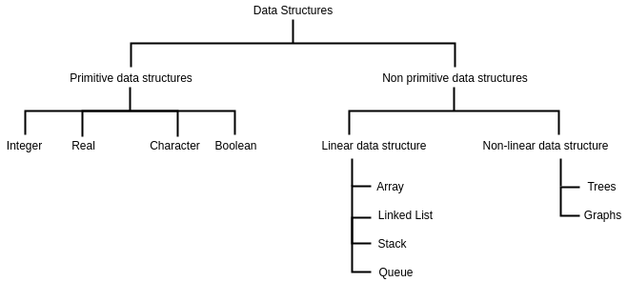
Classification of Data Structures:
Notes:
thinking Rationally: Laws of Thought
Laws of Thought: This is about creating a system that always thinks logically, like following strict rules of reasoning (like math or logic).
Challenges: It’s hard to translate everyday knowledge into strict logical terms, and even if you could, solving problems using these rules can be very slow and complicated.
Example: A program that solves math problems or plays chess by following logical steps.

Slide 24
Classification of Data Structures
Importance: Key to solving problems efficiently, optimizing memory and time.
Two Broad Classifications:
Primitive Data Structures: Built-in types like int, float, char, etc.
Non-Primitive Data Structures: Advanced structures created using primitive types.
Linear Data Structures: Data elements are arranged in a sequential order.
Examples: Arrays, Linked Lists, Stacks, Queues.
Non-Linear Data Structures: Data elements are arranged hierarchically, not in sequence.
Examples: Trees, Graphs.
Static Data Structures: Fixed in size, allocated during compile-time.
Example: Arrays.
Dynamic Data Structures: Can grow or shrink during runtime.
Examples: Linked Lists, Trees, Graphs.

Slide 25
Primitive Data Type:
Integer: The keyword used for integer data types is int. Integers typically require 4 bytes of memory space and range from -2147483648 to 2147483647.
Character: Character data type is used for storing characters. The keyword used for the character data type is char. Characters typically require 1 byte of memory space and range from -128 to 127 or 0 to 255.
Boolean: Boolean data type is used for storing Boolean or logical values. A Boolean variable can store either true or false. The keyword used for the Boolean data type is bool.
Floating Point: Floating Point data type is used for storing single-precision floating-point values or decimal values. The keyword used for the floating-point data type is float. Float variables typically require 4 bytes of memory space.
Double Floating Point: Double Floating Point data type is used for storing double-precision floating-point values or decimal values. The keyword used for the double floating-point data type is double. Double variables typically require 8 bytes of memory space.
void: Void means without any value. void data type represents a valueless entity. A void data type is used for those function which does not return a value.

Slide 26


Slide 27
Arrays
A linear array or a one-dimensional array is the simplest type of data structure. It is a list of a finite number, n, of data elements of a similar type. These elements are represented by a set of consecutive numbers respectively. If A is the array name, then the array elements are represented as any of the following notations.

Slide 28
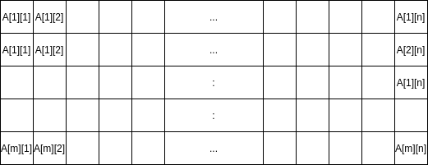
Arrays
A two-dimensional array is a collection of similar data elements where each element is referenced by two subscripts.

Slide 29
Key Characteristics of Array:
Fixed size, defined at the time of declaration.
Elements are indexed starting from 0.
Random access to elements via index.
Syntax
int arr[5] = {10, 20, 30, 40, 50}; // Array initialization
std::cout << arr[0]; // Accesses the first element, prints 10

Slide 30
Array Declaration and Initialization
Declaration: Arrays are declared with a type, name, and size.
Syntax: type arrayName[size];
Example: float prices[10]; // Array of 10 float elements
Initialization: You can initialize arrays at the time of declaration.
Example: int numbers[3] = {1, 2, 3}; // Initializing array with 3 elements
Partial Initialization: When partially initialized, the remaining elements are set to 0.

Slide 31
Accessing and Modifying Array Elements
Accessing Elements: Access an array element using the index in square brackets (arr[index]).
Index starts from 0, so arr[0] refers to the first element.
Modifying Elements: You can assign new values to elements by referencing their index.
int arr[4] = {10, 20, 30, 40};
std::cout << "Element at index 2: " << arr[2] << std::endl; // Prints 30
arr[2] = 50; // Modifying the element at index 2
std::cout << "Modified element: " << arr[2] << std::endl; // Prints 50

Slide 32
Example
int matrix[2][3] = {{1, 2, 3}, {4, 5, 6}};
for (int i = 0; i < 2; i++) {
for (int j = 0; j < 3; j++) {
std::cout << matrix[i][j] << " ";
}
std::cout << std::endl;
}
Output:
1 2 3
4 5 6

Slide 33
Data Structures
& Algorithms
Day - 02
(DSA)

Slide 34

Searching Algorithms

Slide 35
Searching Algorithms
Searching algorithms are essential tools in computer science used to locate specific items within a collection of data.
These algorithms are designed to efficiently navigate through data structures to find the desired information, making them fundamental in various applications such as databases, web search engines, and more.
The primary objective of searching is to determine whether the desired element exists within the data, and if so, to identify its precise location or retrieve it. It plays an important role in various computational tasks and real-world applications, including information retrieval, data analysis, decision-making processes, and more.

Slide 36
Importance of Searching in DSA:
Efficiency: Efficient searching algorithms improve program performance.
Data Retrieval: Quickly find and retrieve specific data from large datasets.
Database Systems: Enables fast querying of databases.
Problem Solving: Used in a wide range of problem-solving tasks.

Slide 37
Applications of Searching:
Information Retrieval: Search engines like Google, Bing, and Yahoo use sophisticated searching algorithms to retrieve relevant information from vast amounts of data on the web.
Database Systems: Searching is fundamental in database systems for retrieving specific data records based on user queries, improving efficiency in data retrieval.
E-commerce: Searching is crucial in e-commerce platforms for users to find products quickly based on their preferences, specifications, or keywords.
Artificial Intelligence: Searching algorithms play a vital role in AI applications, such as problem-solving, game playing (e.g., chess), and decision-making processes
Pattern Recognition: Searching algorithms are used in pattern matching tasks, such as image recognition, speech recognition, and handwriting recognition.

Slide 38
Searching terminologies:
Target Element:
In searching, there is always a specific target element or item that you want to find within the data collection. This target could be a value, a record, a key, or any other data entity of interest.
Search Space:
The search space refers to the entire collection of data within which you are looking for the target element. Depending on the data structure used, the search space may vary in size and organization.
Complexity:
Searching can have different levels of complexity depending on the data structure and the algorithm used. The complexity is often measured in terms of time and space requirements.

Slide 39
Searching Algorithms:
Searching Algorithms are designed to check for an element or retrieve an element from any data structure where it is stored.
Linear Search
Binary Search
Fibonacci Search
Exponential Search

Slide 40
Linear Search
Linear Search, also known as Sequential Search, is one of the simplest and most straightforward searching algorithms.
It works by sequentially examining each element in a collection of data(array or list) until a match is found or the entire collection has been traversed.
The average time complexity of linear search algorithm is O(n), where n is the number of elements in the list or array being searched. This means the time taken for searching increases linearly with the size of the input.

Slide 41
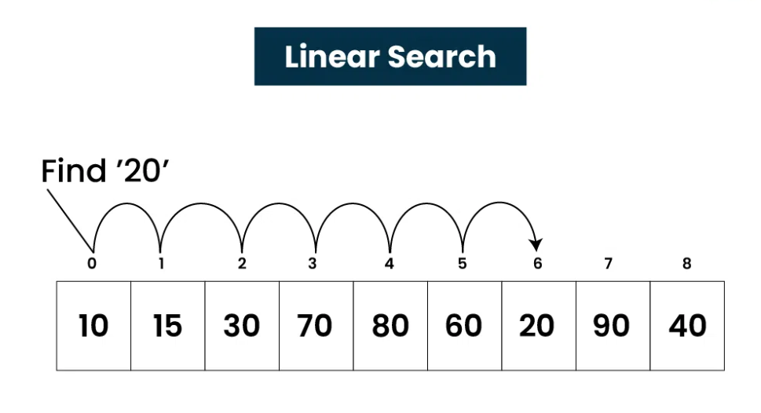
Linear Search

Slide 42
Algorithm for Linear Search Algorithm:
The algorithm for linear search can be broken down into the following steps:
Start: Begin at the first element of the collection of elements.
Compare: Compare the current element with the desired element.
Found: If the current element is equal to the desired element, return true or index to the current element.
Move: Otherwise, move to the next element in the collection.
Repeat: Repeat steps 2-4 until we have reached the end of collection.
Not found: If the end of the collection is reached without finding the desired element, return that the desired element is not in the array.

Slide 43
How does it work?
In Linear Search Algorithm,
Every element is considered as a potential match for the key and checked for the same.
If any element is found equal to the key, the search is successful and the index of that element is returned.
If no element is found equal to the key, the search yields “No match found”.
For example: Consider the array arr[] = {10, 50, 30, 70, 80, 20, 90, 40} and key = 30

Slide 44
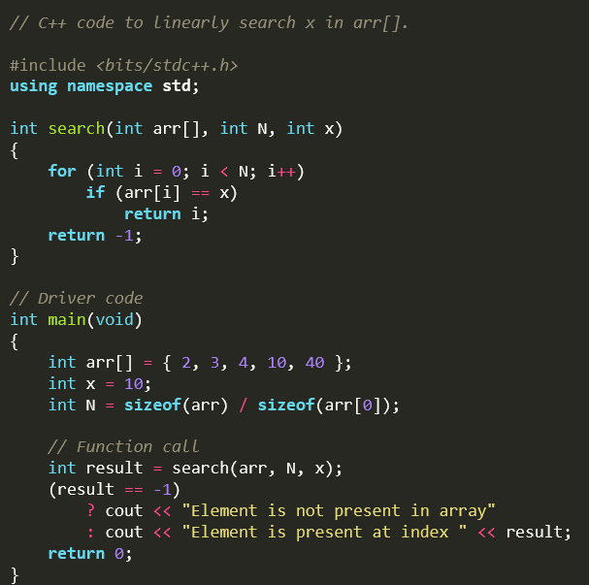
Implementation
In Linear Search, we iterate over all the elements of the array and check if it the current element is equal to the target element. If we find any element to be equal to the target element, then return the index of the current element. Otherwise, if no element is equal to the target element, then return -1 as the element is not found.

Slide 45
Space - Time Complexity
Time Complexity:
Best Case: In the best case, the key might be present at the first index. So the best case complexity is O(1)
Worst Case: In the worst case, the key might be present at the last index i.e., opposite to the end from which the search has started in the list. So the worst-case complexity is O(N) where N is the size of the list.
Average Case: O(N)
Auxiliary Space: O(1) as except for the variable to iterate through the list, no other variable is used.

Slide 46
Applications of Linear Search Algorithm
Unsorted Lists: When we have an unsorted array or list, linear search is most commonly used to find any element in the collection.
Small Data Sets: Linear Search is preferred over binary search when we have small data sets with
Searching Linked Lists: In linked list implementations, linear search is commonly used to find elements within the list. Each node is checked sequentially until the desired element is found.
Simple Implementation: Linear Search is much easier to understand and implement as compared to Binary Search or Ternary Search.

Slide 47
Advantages:
Linear search can be used irrespective of whether the array is sorted or not. It can be used on arrays of any data type.
Does not require any additional memory.
It is a well-suited algorithm for small datasets.
Disadvantages:
Linear search has a time complexity of O(N), which in turn makes it slow for large datasets.
Not suitable for large arrays.

Slide 48


Slide 49
Binary Search
Binary Search Algorithm is a searching algorithm used in a sorted array by repeatedly dividing the search interval in half.
The idea of binary search is to use the information that the array is sorted and reduce the time complexity to O(log N).
It works by repeatedly dividing the search interval in half until the target value is found or the interval is empty.
To apply Binary Search algorithm:
The data structure must be sorted.
Access to any element of the data structure should take constant time.

Slide 50
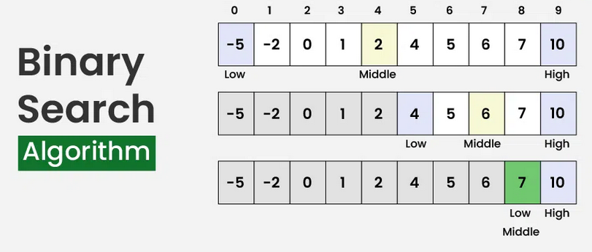
Binary Search

Slide 51
Algorithm for Binary Search Algorithm:
Divide the search space into two halves by finding the middle index “mid”.
Compare the middle element of the search space with the key.
If the key is found at middle element, the process is terminated.
If the key is not found at middle element, choose which half will be used as the next search space.
If the key is smaller than the middle element, then the left side is used for next search.
If the key is larger than the middle element, then the right side is used for next search.
This process is continued until the key is found or the total search space is exhausted.

Slide 52
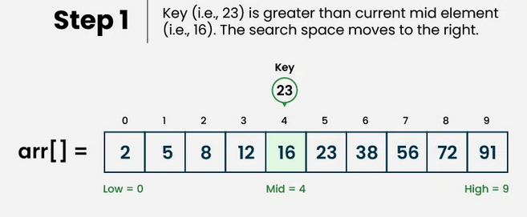
How does it work?
Consider an array arr[] = {2, 5, 8, 12, 16, 23, 38, 56, 72, 91}, and the target = 23.

Slide 53
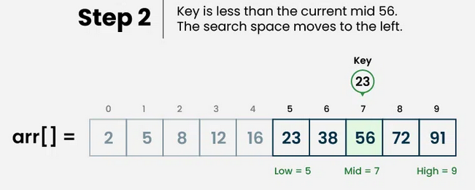
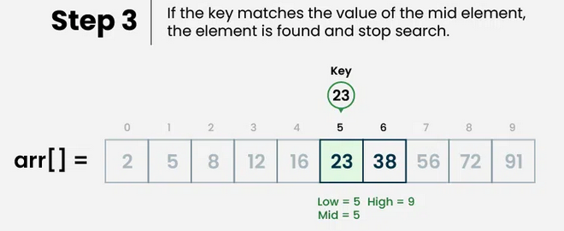

Slide 54
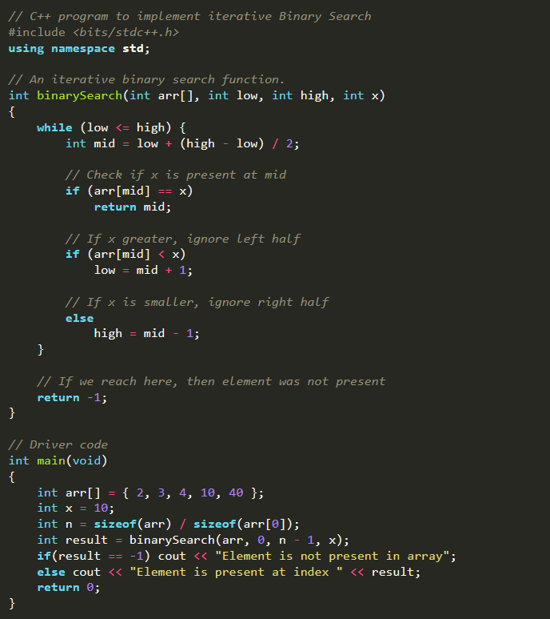
Implementation
Iterative Binary Search: Here we use a while loop to continue the process of comparing the key and splitting the search space in two halves.
Recursive Binary Search Here we create a recursive function and compare the mid of the search space with the key. And based on the result either return the index where the key is found.

Slide 55
Space - Time Complexity
Time Complexity:
Best Case: In the best case, the key might be present at the first index. So the best case complexity is O(1)
Worst Case: In the worst case, the key might be present at the last index i.e., opposite to the end from which the search has started in the list. So the worst-case complexity is O(log N) where N is the size of the list.
Average Case: O(log N)
Auxiliary Space: O(1), If the recursive call stack is considered then the auxiliary space will be O(logN).

Slide 56
Applications of Binary Search Algorithm
Binary search can be used as a building block for more complex algorithms used in machine learning, such as algorithms for training neural networks or finding the optimal hyperparameters for a model.
It can be used for searching in computer graphics such as algorithms for ray tracing or texture mapping.
It can be used for searching a database.

Slide 57
Advantages:
Binary search is faster than linear search, especially for large arrays.
More efficient than other searching algorithms with a similar time complexity, such as interpolation search or exponential search.
Binary search is well-suited for searching large datasets that are stored in external memory, such as on a hard drive or in the cloud.
Disadvantages:
The array should be sorted.
Binary search requires that the data structure being searched be stored in contiguous memory locations.
Binary search requires that the elements of the array be comparable, meaning that they must be able to be ordered.

Slide 58
Introduction to Breadth-First Search (BFS)
Definition:
BFS is an algorithm for traversing or searching tree or graph data structures.
It explores all nodes at the present depth level before moving on to the nodes at the next depth level.
Key Characteristics:
Utilizes a queue (FIFO) to keep track of the next node to explore.
Explores the shortest path first in an unweighted graph.
Use Cases:
Widely used in AI, networking, and other domains where the exploration of a problem space is required.

Slide 59
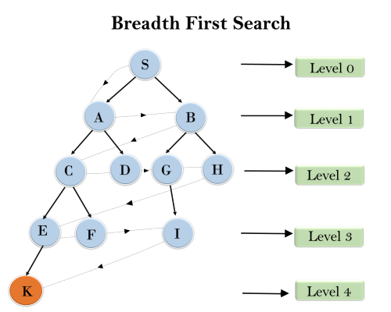
BFS Algorithm Steps
1. Initialization:
Start by inserting the starting node in the queue and mark it as visited.
2. Main Loop:
Dequeue a node from the front, process it.
Enqueue all unvisited adjacent nodes and mark them as visited.
3. Termination:
Repeat the process until the queue is empty or the target node is found.

Slide 60
BFS Applications and Advantages
Applications:
Shortest Path Finding in an unweighted graph.
Web Crawlers for exploring the web.
AI for game playing and solving puzzles.
Peer-to-Peer Networks and Social Networking Sites.
Advantages:
Simple and guarantees the shortest path in an unweighted graph.
Effective in finding the shortest path in shallow or uniform-depth problems.
Limitations:
Not suitable for weighted graphs (Dijkstra’s Algorithm preferred).
Can be memory-intensive for large graphs due to the queue.

Slide 61
Introduction to Depth-First Search (DFS)
What is DFS?
DFS is a tree/graph traversal algorithm.
Explores as far as possible along each branch before backtracking.
Key Concepts:
Stack-Based Approach: Uses a stack to keep track of the path.
Traversal Mechanism: Explores one node, then moves to an adjacent unvisited node.

Slide 62
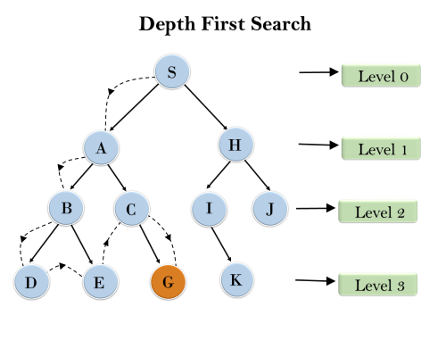
How DFS Works
Step-by-Step Process:
Start from the Root Node: Push the starting node to the stack.
Visit the Next Node: Pop the node from the stack, and push its adjacent unvisited nodes.
Backtrack When Necessary: If no adjacent unvisited nodes are left, backtrack by popping from the stack.
Repeat Until All Nodes are Visited.
Example Application:
Pathfinding in a maze, solving puzzles like Sudoku.

Slide 63
Sorting Algorithms

Slide 64
Sorting Algorithm
A Sorting Algorithm is used to rearrange a given array or list of elements according to a comparison operator on the elements.
The comparison operator is used to decide the new order of elements in the respective data structure.
Sorting means reordering of all the elements either in ascending or in descending order.

Slide 65
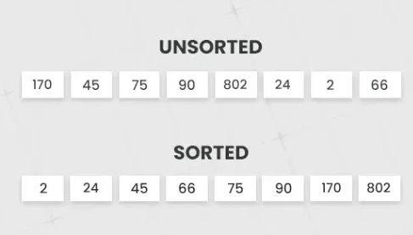

Slide 66
Applications of Sorting:
Searching Algorithms: Sorting is often a crucial step in search algorithms like binary search and Ternary Search. A lot of Greedy Algorithms use sorting as a first step to apply Greedy Approach. For example Activity Selection, Fractional Knapsack, Weighted Job Scheduling, etc
Data management: Sorting data makes it easier to search, retrieve, and analyze. For example the order by operation in SQL queries requires sorting.
Database optimization: Sorting data in databases improves query performance. We preprocess the data by sorting so that efficient searching can be applied.
Machine learning: Sorting is used to prepare data for training machine learning models.
Data Analysis: Sorting helps in identifying patterns, trends, and outliers in datasets. It plays a vital role in statistical analysis, financial modeling, and other data-driven fields.

Slide 67
Sorting terminologies:
Internal Sorting: Internal Sorting is when all the data is placed in the main memory or internal memory. In internal sorting, the problem cannot take input beyond its size. Example: heap sort, bubble sort, selection sort, quick sort, shell sort, insertion sort.
External Sorting : External Sorting is when all the data that needs to be sorted cannot be placed in memory at a time, the sorting is called external sorting. External Sorting is used for the massive amount of data. Examples: Merge sort, Tag sort, Polyphase sort, Four tape sort, External radix sort, etc.
Stable sorting: When two same items appear in the same order in sorted data as in the original array called stable sort. Examples: Merge Sort, Insertion Sort, Bubble Sort.
Unstable sorting: When two same data appear in the different order in sorted data it is called unstable sort. Examples: Selection Sort, Quick Sort, Heap Sort, Shell Sort.

Slide 68
Characteristics
Time Complexity: Time complexity, a measure of how long it takes to run an algorithm, is used to categorize sorting algorithms. The worst-case, average-case, and best-case performance of a sorting algorithm can be used to quantify the time complexity of the process.
Auxiliary Space : This is the amount of extra space (apart from input array) needed to sort. For example, Merge Sort requires O(n) and Insertion Sort O(1) auxiliary space
Stability: A sorting algorithm is said to be stable if the relative order of equal elements is preserved after sorting. This is important in certain applications where the original order of equal elements must be maintained.
In-Place Sorting: An in-place sorting algorithm is one that does not require additional memory to sort the data. This is important when the available memory is limited or when the data cannot be moved.

Slide 69
Sorting Algorithms:
Searching Algorithms are designed to check for an element or retrieve an element from any data structure where it is stored.
Bubble Sort
Selection Sort
Insertion Sort
Merge Sort
Quicksort

Slide 70
Bubble Sort Algorithm
Bubble Sort is the simplest sorting algorithm that works by repeatedly swapping the adjacent elements if they are in the wrong order. This algorithm is not suitable for large data sets as its average and worst-case time complexity are quite high.
We sort the array using multiple passes. After the first pass, the maximum element goes to end (its correct position). Same way, after second pass, the second largest element goes to second last position and so on.
In every pass, we process only those elements that have already not moved to correct position. After k passes, the largest k elements must have been moved to the last k positions.

Slide 71
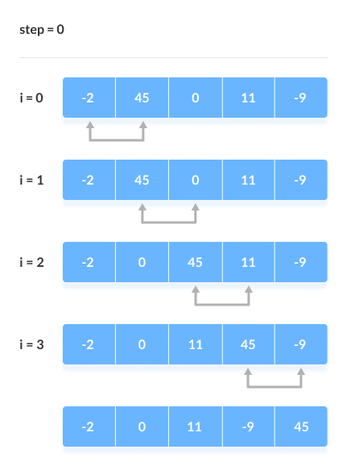
How does it work
Bubble sort is a simple algorithm that sorts a list of numbers or other elements by comparing adjacent elements and swapping them if they are out of order:
Start: Begin with the first element of the list.
Compare: Compare the current element with the next element.
Swap: If the elements are out of order, swap their positions.
Repeat: Repeat the process until the entire list is sorted.

Slide 72
Complexity Analysis of Bubble Sort:
Time Complexity:
Best Case: O(n), When the array is already sorted or nearly sorted.
Average Case: O(n^2), When the array is randomly ordered.
Worst Case: O(n^2), When the array is sorted in reverse order.
Auxiliary Space:
O(1), Additional space is required for the temporary array used during merging.

Slide 73
Applications of Bubble Sort:
Large data sets: Bubble sort is efficient for sorting large arrays or lists because of its O(n log n) time complexity.
External sorting: Bubble sort can sort large data sets that are too big to fit in memory.
Linked lists: Bubble sort is efficient for sorting linked lists because it doesn't require random access to elements.

Slide 74
Advantages of Bubble Sort:
Stability : Merge sort is a stable sorting algorithm, which means it maintains the relative order of equal elements in the input array.
Guaranteed worst-case performance: Merge sort has a worst-case time complexity of O(N logN) , which means it performs well even on large datasets.
Simple to implement: The divide-and-conquer approach is straightforward.
Disadvantages of Bubble Sort:
Space complexity: Merge sort requires additional memory to store the merged sub-arrays during the sorting process.
Not in-place: Merge sort is not an in-place sorting algorithm, which means it requires additional memory to store the sorted data. This can be a disadvantage in applications where memory usage is a concern.
Slower than QuickSort in general. QuickSort is more cache friendly because it works in-place.

Slide 75


Slide 76
Merge Sort
Merge sort is a sorting algorithm that follows the divide-and-conquer approach. It works by recursively dividing the input array into smaller subarrays and sorting those subarrays then merging them back together to obtain the sorted array.
In simple terms, we can say that the process of merge sort is to divide the array into two halves, sort each half, and then merge the sorted halves back together. This process is repeated until the entire array is sorted.

Slide 77
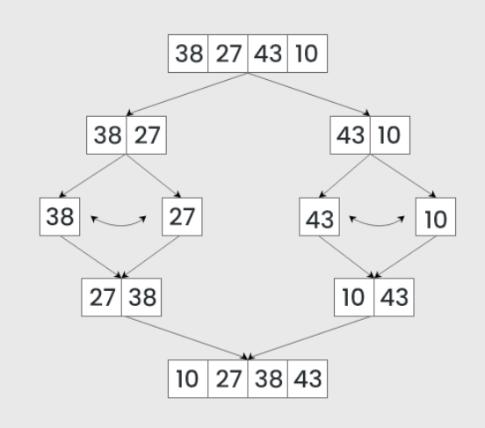
How does it work
Here’s a step-by-step explanation of how merge sort works:
Divide: Divide the list or array recursively into two halves until it can no more be divided.
Conquer: Each subarray is sorted individually using the merge sort algorithm.
Merge: The sorted subarrays are merged back together in sorted order. The process continues until all elements from both subarrays have been merged.

Slide 78
Complexity Analysis of Merge Sort:
Time Complexity:
Best Case: O(n log n), When the array is already sorted or nearly sorted.
Average Case: O(n log n), When the array is randomly ordered.
Worst Case: O(n log n), When the array is sorted in reverse order.
Auxiliary Space:
O(n), Additional space is required for the temporary array used during merging.

Slide 79
Applications of Merge Sort:
Sorting large datasets
External sorting (when the dataset is too large to fit in memory)
Inversion counting
Merge Sort and its variations are used in library methods of programming languages. For example its variation TimSort is used in Python, Java Android and Swift. The main reason why it is preferred to sort non-primitive types is stability which is not there in QuickSort. For example Arrays.sort in Java uses QuickSort while Collections.sort uses MergeSort.
It is a preferred algorithm for sorting Linked lists.
It can be easily parallelized as we can independently sort subarrays and then merge.

Slide 80
Advantages of Merge Sort:
Stability : Merge sort is a stable sorting algorithm, which means it maintains the relative order of equal elements in the input array.
Guaranteed worst-case performance: Merge sort has a worst-case time complexity of O(N logN) , which means it performs well even on large datasets.
Simple to implement: The divide-and-conquer approach is straightforward.
Disadvantages of Merge Sort:
Space complexity: Merge sort requires additional memory to store the merged sub-arrays during the sorting process.
Not in-place: Merge sort is not an in-place sorting algorithm, which means it requires additional memory to store the sorted data. This can be a disadvantage in applications where memory usage is a concern.
Slower than QuickSort in general. QuickSort is more cache friendly because it works in-place.

Slide 81
Quick Sort Algorithm
QuickSort is a sorting algorithm based on the Divide and Conquer that picks an element as a pivot and partitions the given array around the picked pivot by placing the pivot in its correct position in the sorted array.
Quicksort picks an element as pivot, and then it partitions the given array around the picked pivot element. In quick sort, a large array is divided into two arrays in which one holds values that are smaller than the specified value (Pivot), and another array holds the values that are greater than the pivot.
After that, left and right sub-arrays are also partitioned using the same approach. It will continue until the single element remains in the sub-array.

Slide 82
How does it work
Choose a Pivot: Select an element from the array as the pivot. The choice of pivot can vary (e.g., first element, last element, random element, or median).
Partition the Array: Rearrange the array around the pivot. After partitioning, all elements smaller than the pivot will be on its left, and all elements greater than the pivot will be on its right. The pivot is then in its correct position, and we obtain the index of the pivot.
Recursively Call: Recursively apply the same process to the two partitioned sub-arrays (left and right of the pivot).
Base Case: The recursion stops when there is only one element left in the sub-array, as a single element is already sorted.

Slide 83
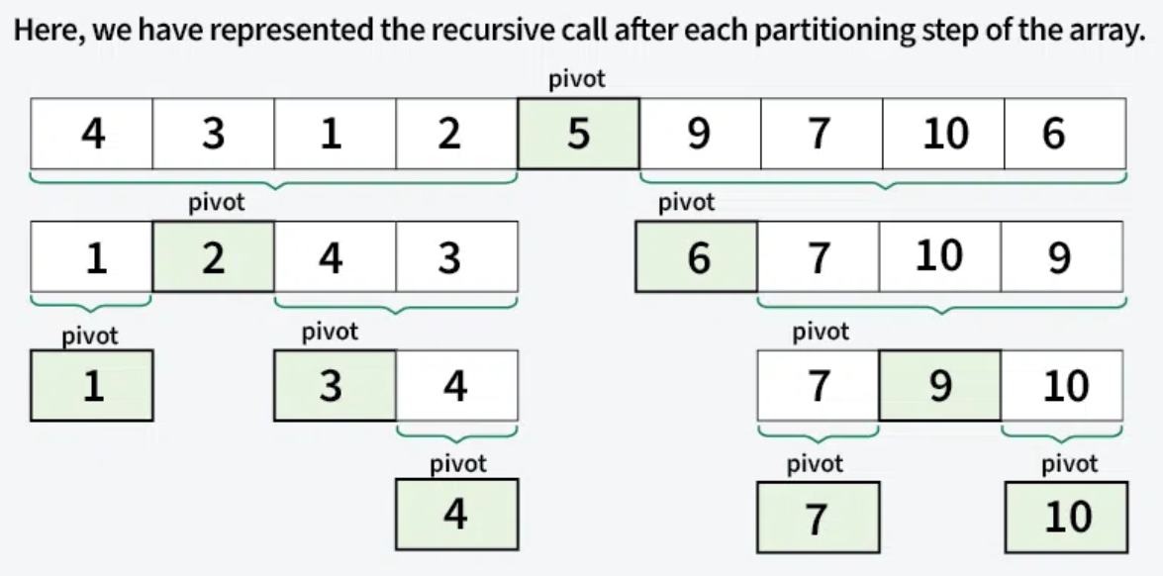

Slide 84
Choice of Pivot
There are many different choices for picking pivots.
Always pick the first (or last) element as a pivot. The below implementation is picks the last element as pivot. The problem with this approach is it ends up in the worst case when array is already sorted.
Pick a random element as a pivot. This is a preferred approach because it does not have a pattern for which the worst case happens.
Pick the median element is pivot. This is an ideal approach in terms of time complexity as we can find median in linear time and the partition function will always divide the input array into two halves. But it is low on average as median finding has high constants.

Slide 85
Complexity Analysis of Quick Sort:
Time Complexity:
Best Case: O(n*logn), when the pivot element is middle element.
Average Case:O(n*logn), when the pivot element is jumbled.
Worst Case: O(n²), when the pivot element is either greatest or smallest element.

Slide 86
Applications of Quick Sort:
Efficient for sorting large datasets with O(nlogn) average-case time complexity.
Used in partitioning problems like finding the kth smallest element or dividing arrays by pivot.
Integral to randomized algorithms, offering better performance than deterministic approaches.
Applied in cryptography for generating random permutations and unpredictable encryption keys.
Partitioning step can be parallelized for improved performance in multi-core or distributed systems.
Important in theoretical computer science for analyzing average-case complexity and developing new techniques.

Slide 87
Advantages of Quick Sort:
It is a divide-and-conquer algorithm that makes it easier to solve problems.
It is efficient on large data sets.
It has a low overhead, as it only requires a small amount of memory to function.
It is Cache Friendly as we work on the same array to sort and do not copy data to any auxiliary array.
Fastest general purpose algorithm for large data when stability is not required.
Disadvantages of Quick Sort:
It has a worst-case time complexity of O(n2), which occurs when the pivot is chosen poorly.
It is not a good choice for small data sets.
It is not a stable sort, meaning that if two elements have the same key, their relative order will not be preserved in the sorted output in case of quick sort,

Slide 88
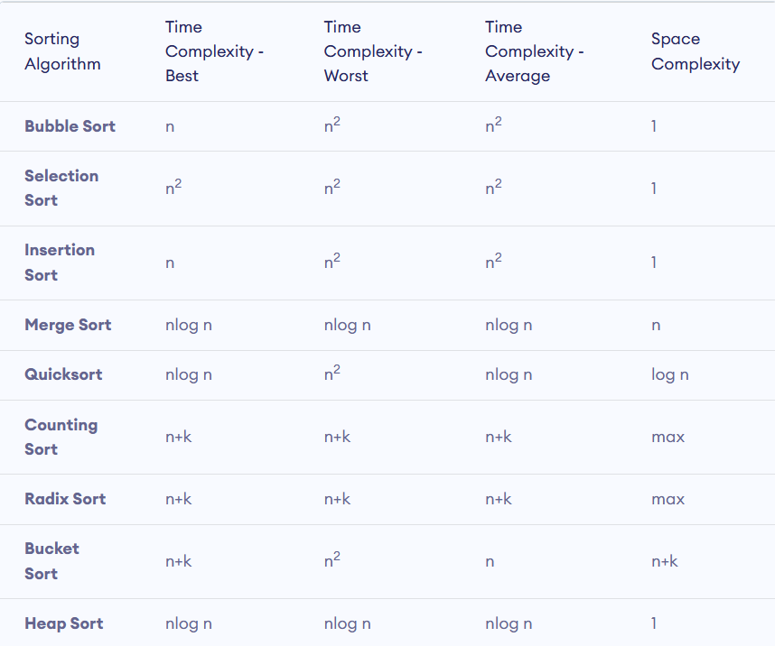

Slide 89
Thanks!

Slide 90
Data Structures
& Algorithms
Day - 03
(DSA)

Slide 91
Linked Lists
Linked List can be defined as collection of objects called nodes that are randomly stored in the memory.
A node contains two fields i.e. data stored at that particular address and the pointer which contains the address of the next node in the memory.
The last node of the list contains pointer to the null.

Slide 92
Why use linked list over array?
Array contains following limitations:
The size of array must be known in advance before using it in the program.
Increasing size of the array is a time taking process. It is almost impossible to expand the size of the array at run time.
All the elements in the array need to be contiguously stored in the memory. Inserting any element in the array needs shifting of all its predecessors.
Where as, a Linked List has the following features:
It allocates the memory dynamically. All the nodes of linked list are non-contiguously stored in the memory and linked together with the help of pointers.
Sizing is no longer a problem since we do not need to define its size at the time of declaration. List grows as per the program's demand and limited to the available memory space.

Slide 93
Uses of Linked List
The list is not required to be contiguously present in the memory. The node can reside anywhere in the memory and linked together to make a list. This achieves optimized utilization of space.
list size is limited to the memory size and doesn't need to be declared in advance.
Empty node can not be present in the linked list.
We can store values of primitive types or objects in the singly linked list.

Slide 94
Types of Linked List
Based on the ability of a linked list to store the address, we have different types of Linked Lists.
Single Linked List
Doubly Linked List
Circular Linked List
Doubly Circular Linked List

Slide 95
Singly linked list or One way chain
One way chain or singly linked list can be traversed only in one direction. In other words, we can say that each node contains only next pointer, therefore we can not traverse the list in the reverse direction.
Consider an example where the marks obtained by the student in three subjects are stored in a linked list as shown in the figure.

Slide 96
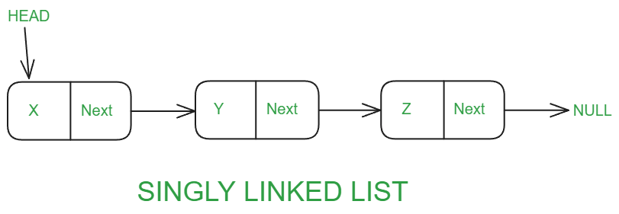
The singly linked list is the simplest form of linked list in which the node contain two members data and a next pointer that stores the address of the next node. Each node is a singly linked list is connected through the next pointer and the next pointer of the last node points to NULL denoting the end of the linked list. The following diagram describes the structure of a singly linked list:

Slide 97
Operations on Singly Linked List
Node Creation:
struct node
{
int data;
struct node *next;
};
struct node *head, *ptr;
ptr = (struct node *)malloc(sizeof(struct node *));

Slide 98
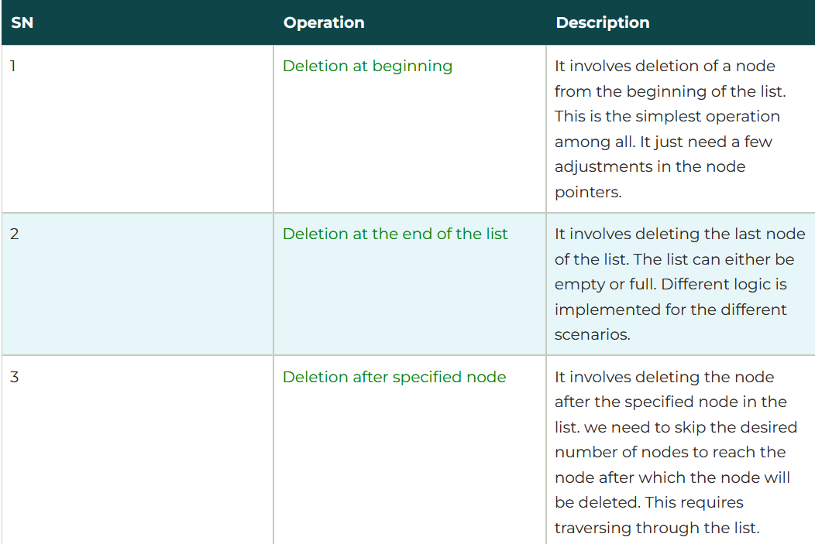
3. Deletion

Slide 99
Doubly Linked List
The doubly linked list is the modified version of the singly linked list where each node of the doubly linked consists of three data members data ,next and prev. The prev is a pointer that stores the address of the previous node in the linked list sequence. Each node in a doubly linked list except the first and the last node is connected with each other through the prev and next pointer. The prev pointer of the first node and the next pointer of the last node points to NULL in the doubly linked list.

Slide 100
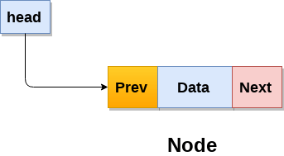
Doubly Linked List
The doubly linked list is the modified version of the singly linked list where each node of the doubly linked consists of three data members data ,next and prev. The prev is a pointer that stores the address of the previous node in the linked list sequence.
Each node in a doubly linked list except the first and the last node is connected with each other through the prev and next pointer. The prev pointer of the first node and the next pointer of the last node points to NULL in the doubly linked list.

Slide 101
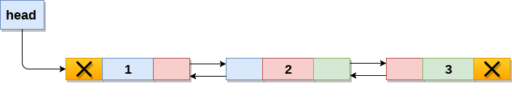
A doubly linked list containing three nodes having numbers from 1 to 3 in their data part, is shown in the above image. The prev part of the first node and the next part of the last node will always contain null indicating end in each direction.
In a singly linked list, we could traverse only in one direction, because each node contains address of the next node and it doesn't have any record of its previous nodes. However, doubly linked list overcome this limitation of singly linked list.

Slide 102
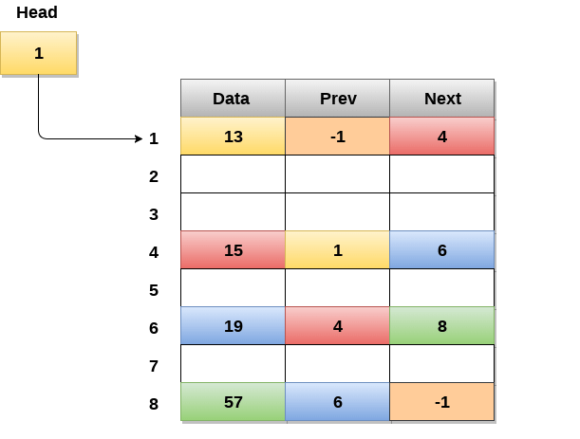
Memory Representation of a doubly linked list is shown in the following image.
Generally, doubly linked list consumes more space for every node and therefore, causes more expansive basic operations such as insertion and deletion.
However, we can easily manipulate the elements of the list since the list maintains pointers in both the directions (forward and backward).
In the following image, the first element of the list that is i.e. 13 stored at address 1. The head pointer points to the starting address 1. Since this is the first element being added to the list therefore the prev of the list contains null. The next node of the list resides at address 4 therefore the first node contains 4 in its next pointer.

Slide 103


Slide 104
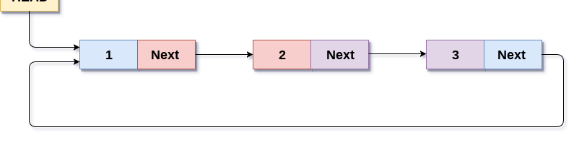
Circular Linked List
In a circular Singly linked list, the last node of the list contains a pointer to the first node of the list. We can have circular singly linked list as well as circular doubly linked list.
We traverse a circular singly linked list until we reach the same node where we started. The circular singly liked list has no beginning and no ending. There is no null value present in the next part of any of the nodes.

Slide 105
A circular linked list is a special type of linked list where all the nodes are connected to form a circle. Unlike a regular linked list, which ends with a node pointing to NULL, the last node in a circular linked list points back to the first node. This means that you can keep traversing the list without ever reaching a NULL value.
We can also have more than one number of linked list in the memory with the different start pointers pointing to the different start nodes in the list. The last node is identified by its next part which contains the address of the start node of the list. We must be able to identify the last node of any linked list so that we can find out the number of iterations which need to be performed while traversing the list.

Slide 106
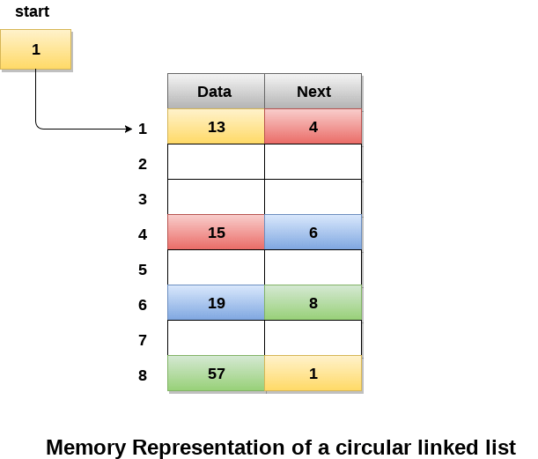
In the following image, memory representation of a circular linked list containing marks of a student in 4 subjects.
However, the image shows a glimpse of how the circular list is being stored in the memory.
The start or head of the list is pointing to the element with the index 1 and containing 13 marks in the data part and 4 in the next part.
Which means that it is linked with the node that is being stored at 4th index of the list.
However, due to the fact that we are considering circular linked list in the memory therefore the last node of the list contains the address of the first node of the list.

Slide 107
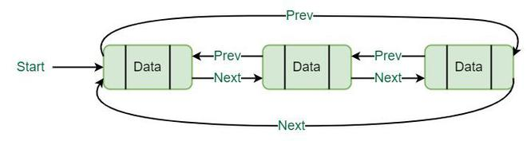
Doubly Circular Linked List
A circular doubly linked list has the following properties:
Circular: A circular doubly linked list’s main feature is that it is circular in design.
Doubly Linked: Each node in a circular doubly linked list has two pointers – one pointing to the node before it and the other pointing to the node after it.
Header Node: At the start of circular doubly linked lists, a header node or sentinel node is frequently used. This node is used to make the execution of certain operations on the list simpler even though it is not a component of the list’s actual contents.

Slide 108
Applications of Circular Doubly Linked List :
Implementation of Circular Data Structures: Circular doubly linked lists are extremely helpful in the construction of circular data structures like circular queues and circular buffers, which are both circular in nature.
Implementing Undo-Redo Operations: Text editors and other software programs can use circular doubly linked lists to implement undo-redo operations.
Music Player Playlist: Playlists in music players are frequently implemented using circular doubly linked lists. Each song is kept as a node in the list in this scenario, and the list can be circled to play the songs in the order they are listed.
Cache Memory Management: To maintain track of the most recently used cache blocks, circular doubly linked lists are employed in cache memory management.

Slide 109
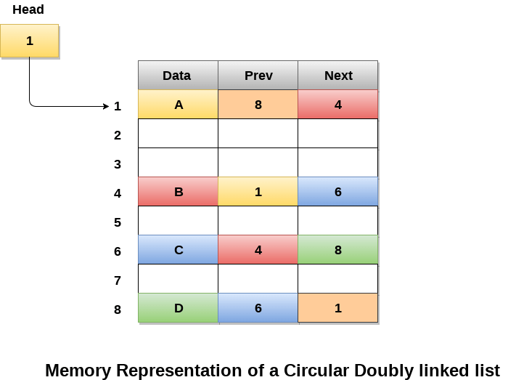
The following figure shows the way in which the memory is allocated for a circular doubly linked list.
The variable head contains the address of the first element of the list i.e. 1 hence the starting node of the list contains data A is stored at address 1.
Since, each node of the list is supposed to have three parts therefore, the starting node of the list contains address of the last node i.e. 8 and the next node i.e. 4.
The last node of the list that is stored at address 8 and containing data as 6, contains address of the first node of the list as shown in the image i.e. 1.

